Slide 1
DiagnosticSourcery Diagnostics, Metrics and Tracing in .NET
Mark Rendle @markrendle rendlelabs.com

Slide 2
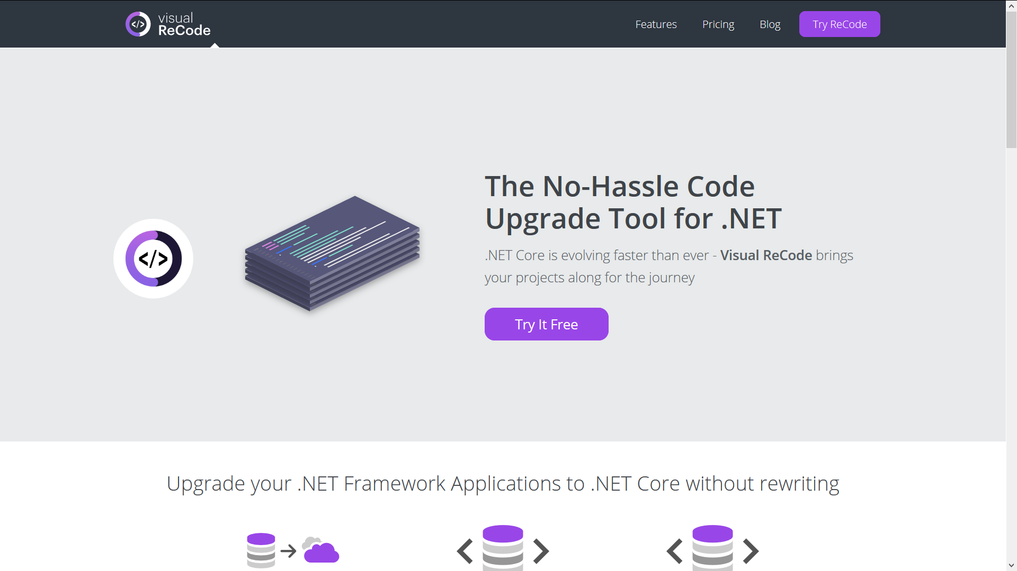

Slide 3
visualrecode.com
Magically modernize .NET applications

Slide 4
Why Is He On About This Now?
You can't improve what you don't measure
It's not just web apps and microservices
Dashboards Are Cool

Slide 5
Metrics vs Logs
Not the same thing

Slide 6
Metrics vs Logs
Metrics
Logs
Numbers
Charts
Aggregation
Performance etc.
Text
Error messages
Information
Searchable

Slide 7
APM
Application Performance Management

Slide 8
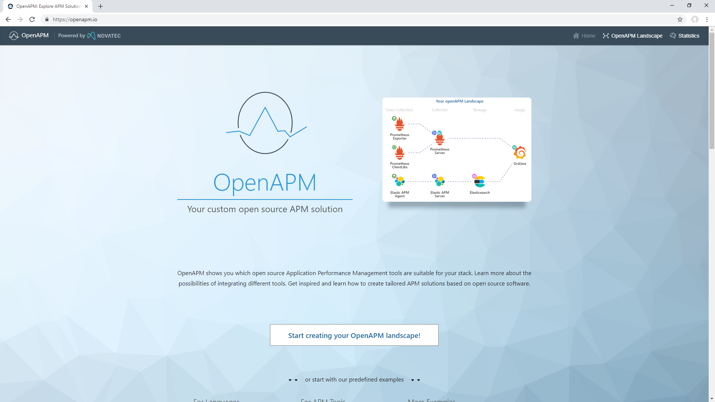

Slide 9
What To Measure?

Slide 10
What to measure
Number of events
Throughput
Timings
Number of errors
System data

Slide 11
Web applications
Requests (total, per minute, etc.)
Page / Area accesses
Response times
Response Status Codes
Error counts
Database or HTTP request timings

Slide 12
Native applications
Startup time
Feature usage
Performance
Errors
Database / HTTP request timings

Slide 13
System data
CPU
Memory
Disk
Network
I/O
CLR

Slide 14
How To Measure?

Slide 15
Abstraction
How to do metrics
when you can't agree on tools

Slide 16
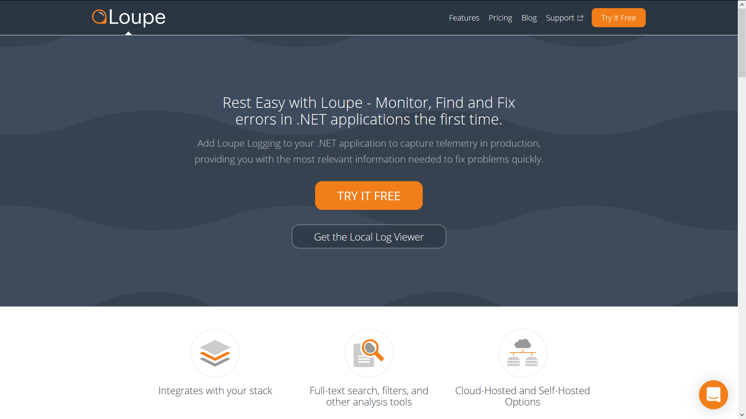

Slide 17
DiagnosticSource
nuget.org/packages/System.Diagnostics.DiagnosticSource

Slide 18
DiagnosticSource
.NET Framework
Write Events
Trace Activities
Listen for Events

Slide 19
Writing events

Slide 20
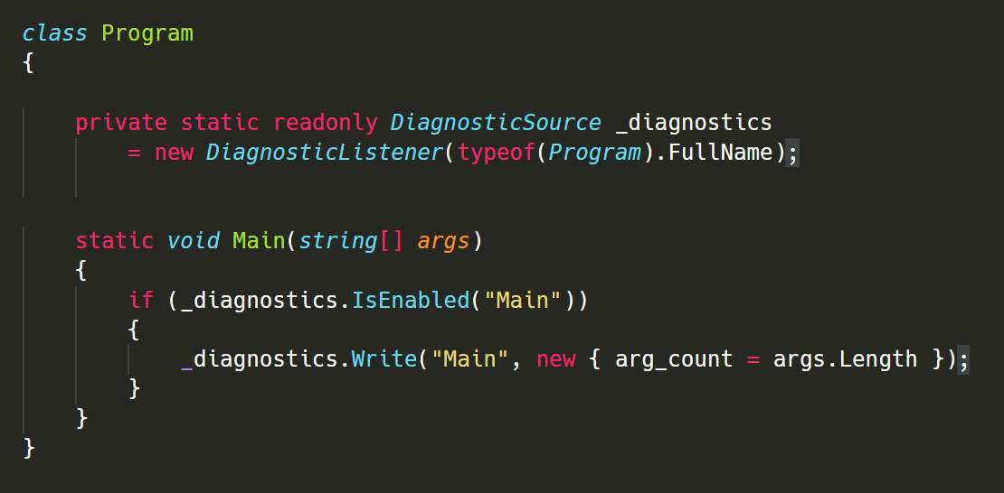

Slide 21
Activities

Slide 22
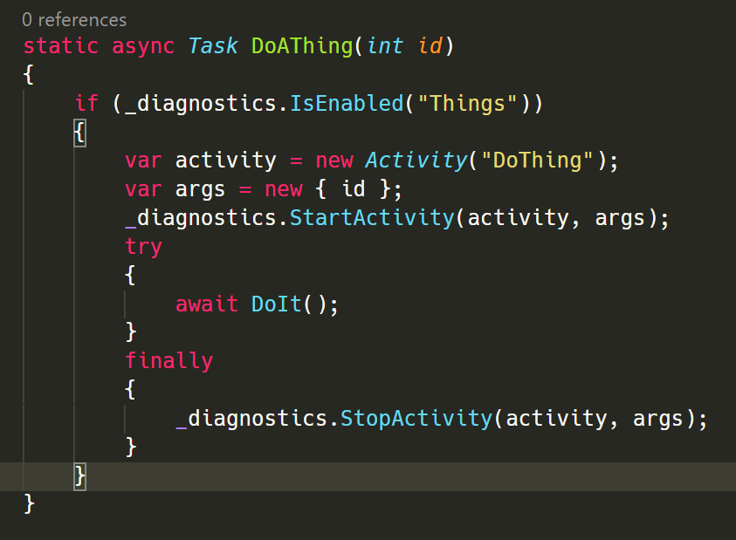

Slide 23
Demo
Writing and Reading

Slide 24
Upstream support

Slide 25
DiagnosticSource in .NET
ASP.NET Core
Entity Framework Core
HttpClient
…

Slide 26
ASP.NET Core
Timings for handling requests, executing views, etc
Supports Request-ID & Correlation-Context headers

Slide 27
HttpClient
Timings for running requests
Supports Request-ID & Correlation-Context headers

Slide 28
HTTP Correlation Protocol
Request-ID: |9823hfho8hao84fh.bf7w3shf_1.
Correlation-Context: UID=42, HID=DT007

Slide 29
Reading events

Slide 30
DiagnosticSource -> InfluxDB

Slide 31
things,host=SRV001,dc=ln count=7 98273423987
Measurement
Tags
Fields
Timestamp
InfluxDB Line Format

Slide 32
Code
RendleLabs.InfluxDB.DiagnosticSourceListener

Slide 33
DiagnosticSource -> Distributed Tracing

Slide 34
OpenTelemetry opentelemetry.io

Slide 35
Jaeger jaegertracing.io

Slide 36
Summary
Measure everything
Time Series databases (e.g. InfluxDB, Prometheus)
Grafana dashboards
OpenTelemetry
Jaeger
DiagnosticSource:
Abstraction from specific libraries
Upstream metrics and events

Slide 37
github.com/RendleLabs/DiagnosticSourcery

